Slide 1
Sensing the Pulse of Urban Refueling Behavior
Fuzheng Zhang University of Science and Technology of China
David Wilkie University of North Carolina at Chapel Hill
Yu Zheng Microsoft Research Asia
Xing Xie Microsoft Research Asia
Notes:
Good morning, everyone.
I am .., come from …, I am currently an intern in the DKE lab
It is my great honour to present …..
This work is in collaboration with David,….

Slide 2
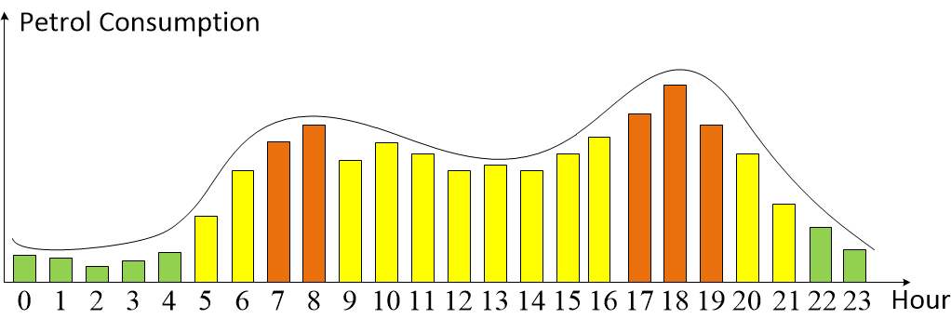
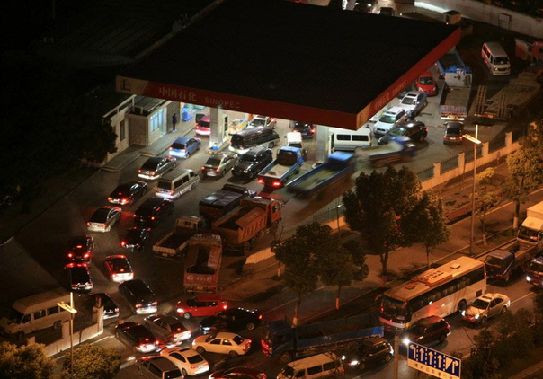
Notes:
Since the popularization of cars, refueling has been an daily routine for vehicle owners. With the increasing of refueling demand and current layout of gas stations in a city, more and more issues have been related to this topic. E.g., the picture in the middle indicate the endless waiting time is needed in the station. It is becoming more and more necessary to understand drivers’ refueling behavior.
In the past, sociologist had to spent amount of time question the subjects in the field, and the results are based on small-scale sampling interviewers. With the prevalence of ubiquitous sensors, such as GPS device or smart phones, it is becoming possible to understand these behaviors automatically from the data generated. Our work concentrate on understanding this behavior in a complete data-driven and crowd souring way.
A lot of applications can benefit from understanding drivers’ refueling behavior.
In top-left corner, assume a user is in position where the red arrow point,
In top-right corner, if we know how many customers have visited each station, we could plot the dynamic scenario of fuel use in this city. In the rush hours
The bottom two pictures show the refueling consumption could guide the urban planning.

Slide 3
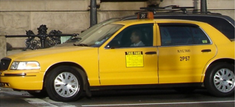
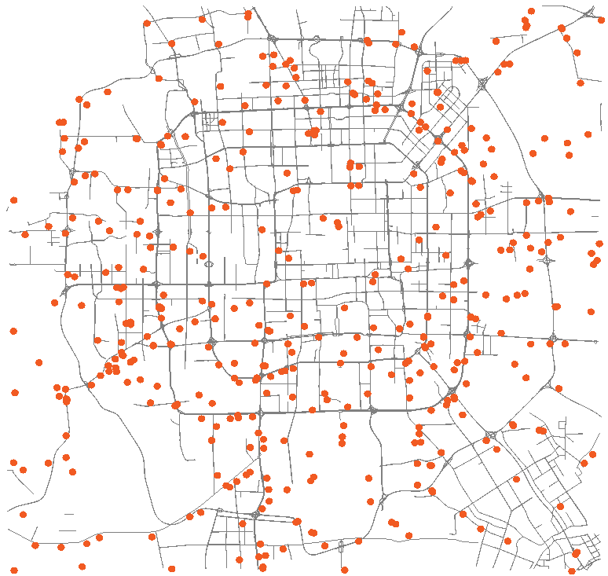
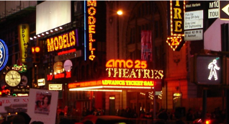
Raw Trajectories | Total Taxi Number | 32,476
 | Duration | 54 day
 | Ave Distance By Day | 226.76 km
 | Ave Sampling Interval | 1.02 minute
POIs | Total Number | 369,668
 | Category Number | 602
 | Gas stations | 689
Road Network | Road Nodes | 106,579
 | Road Segments | 141,380
Notes:
First, I want to introduce the datasets we used in this system.
It contains three parts.
First is taxi trajectories, trajectories is the sequence of GPS points, contains latitude, longitude and timestamp.
Second is POIs, poi is the semantic description of location, which contains latitude, longitude and category.
Third is Road network, is road description of this city, contains road nodes and segments.

Slide 4
Overview
Notes:
OK, let’s first take an overview of this system.

Slide 5
Refueling Detection
Time Spent Estimate
Visit Estimate
Refueling Behavior Analysis
Notes:
There are four components in our system.
First is refueling detection, try to find out the part of trajectory which indicate the refueling behavior
Second is the time spent estimate, which try to understand how much would be spent at a gas station in a given time
Third is the visit estimate, try to estimate how many vehicles have visited the gas station during a period
Last is the city’s refueling behavior analysis

Slide 6
Refueling Detection
Notes:
OK, let’s first have a look at refueling detection

Slide 7
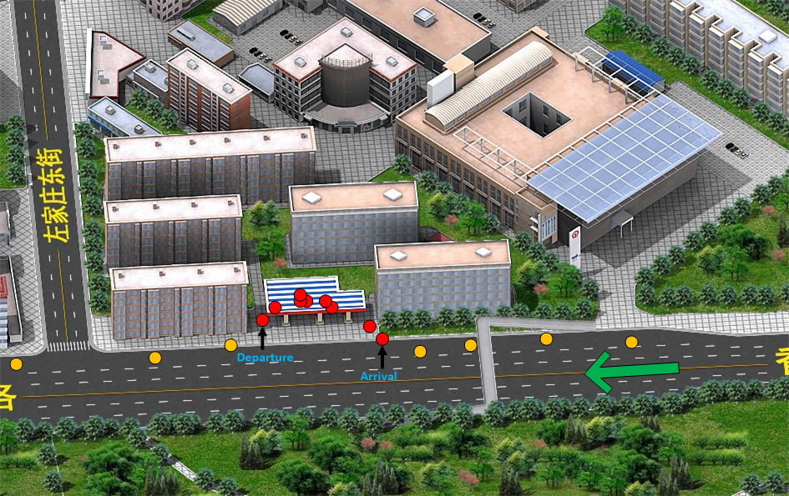
Refueling Event
Arrival Point
Departure Point
Selected Station
Notes:
Refueling event is a sequence of continuous GPS points, which means the driver is refueling or waiting for refueling, contains three factors ….arrival point,
In this figure, the colored point indicate the GPS point, from right to left, the red one is the points in refueling event. We want to find out the first red point and the last red point,

Slide 8
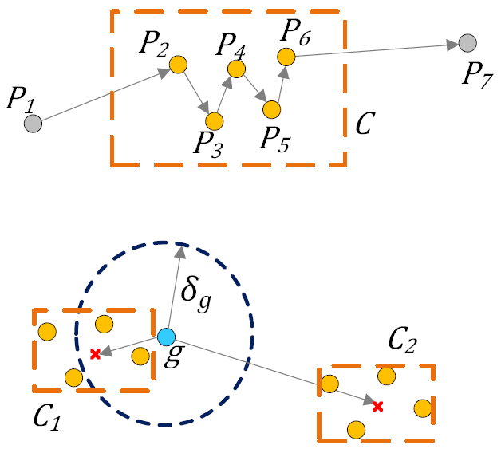
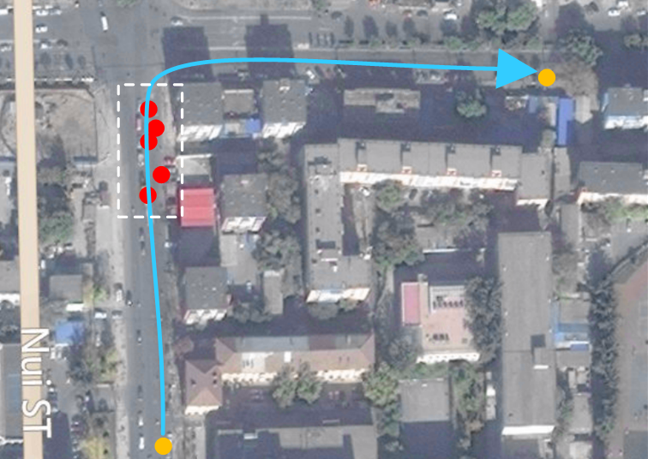
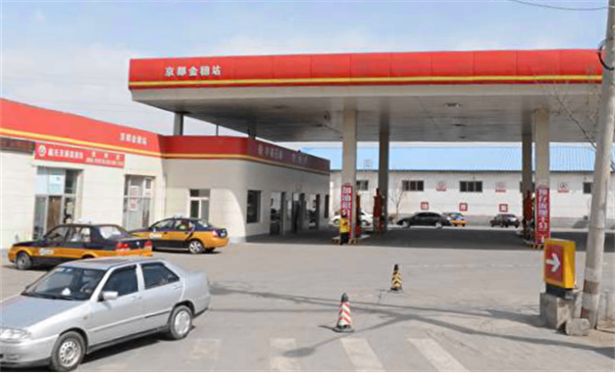
Candidate Extraction
Mobility Constraint : Stay Point Detection
Geographic Constraints
Filtering
Spatial-Temporal Features
Gas Station Distance, Distance to Road, etc.
Gradient Tree Boosting Classifier, manually labeled datasets
Notes:
How can we find it out. It is easy to see, there are two constraints related to refueling, mobility and geographic.
For mobility reason, they drivers had to slow down when it is near to the station. A spatial-temporal cluster in the original trajectory.
For geographic reason, the refueling points should be as close to the station as possible. We would choose these clusters fall in the neighbourhood of the station.
After we find out these candidates, we want to filter some pseudo ones. Because some other behaviors, such as parking or traffic jam, could also generate similar mobility patterns.

Slide 9
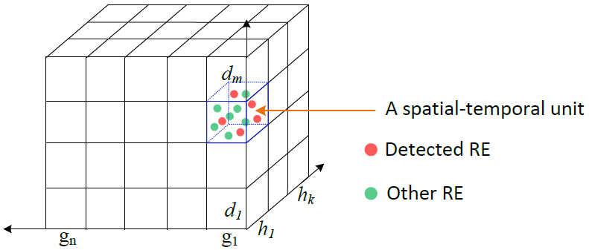
Spatial-Temporal Space
Each Unit
Time Spent
Visit
Notes:
Knowledge cell is a division for spatial-temporal space, we divide time by different days and different hours, divide space by different gas station. Each cell represents the knowledge we want to know for a station at a special time period. In the following, we focus on two quantities, time spent and visit.

Slide 10
Time Spent Estimate
Notes:
OK, Let’s detail how estimate time spent

Slide 11
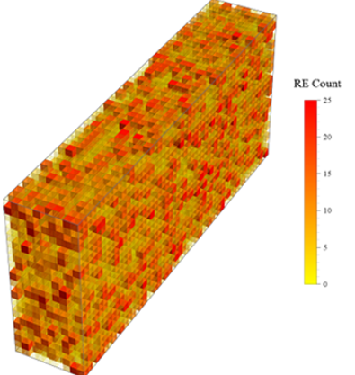
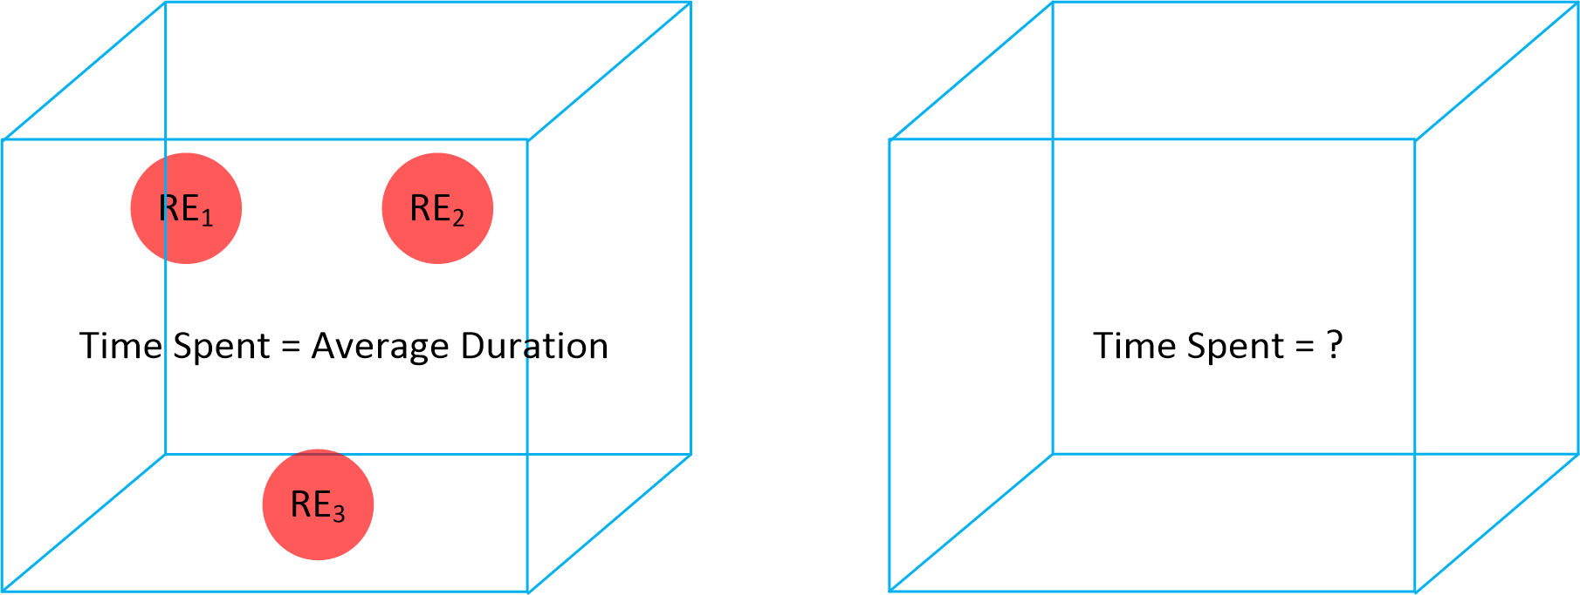
Data Sparsity
Notes:
The time spent of a cell means the average time needed to wait and refuel in the station at that moment. We want to know the time spent for each cell.
For those with enough detected refueling event, we use their average time spent to estimate.
But how about the remaining ones, the figure shows the heatmap of cell, the color means the number of detected refueling event, we cans see many cells have few or even no incorporated, we want to solve the data sparsity problem.

Slide 12
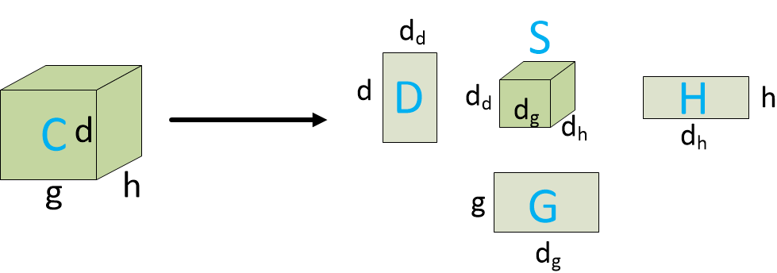
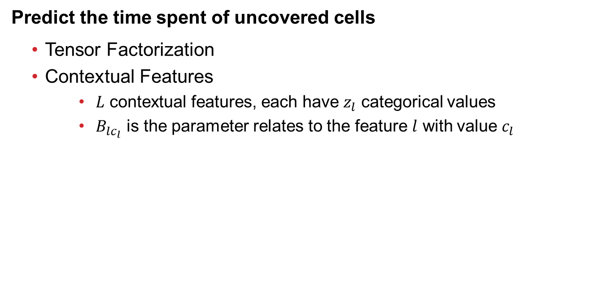
Predict the time spent of uncovered cells
Tensor Factorization
Contextual Features
$L$ contextual features, each have $z_{l}$ categorical values
$B_{lc_{l}}$ is the parameter relates to the feature $l$ with value $c_{l}$
Notes:
For those cells with enough detected refueling event, we estimate the time spent with average value and treat them as observable ones. As we know, this scenario is quite similar to recommender system.
Then we can use tensor factorization method to estimate other cells’ values.
This factorization method only use observations, we want make use of some factors which influence drivers’ refueling choice and thus influence the time spent in a station. We assume there are L factors, each factor have several values, then the final model to estimate the value of a cell is …

Slide 13
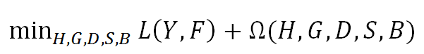
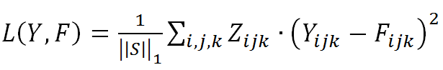
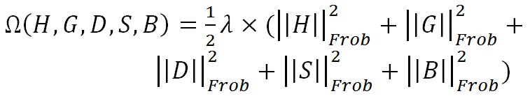
Objective Function
Notes:
So our problem becomes an optimization problem. The objective function is to minimize this term
Where the first term is the accumulated error
The second term is the regularization

Slide 14
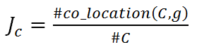
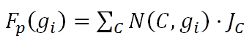
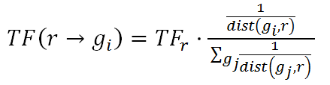
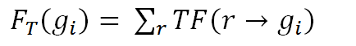
Contextual Feature Engineering
POI Feature
Traffic feature
Area feature
Notes:
More ever, we consider three contextual factors that influence drivers’ refueling choice.
The first term is POI feature, It calculate the attraction of the station, which is given by its nearby POIs.
The second term is Traffic feature, which represent the nearby traffic flow for this station, more larger, more drivers’ would like to refuel
The third term is area feature, which means the capability of the station. If the consumers is the same, larger stations means less waiting time is needed.

Slide 15
Visit Estimate
Notes:
Then, I will detail the visit estimate

Slide 16
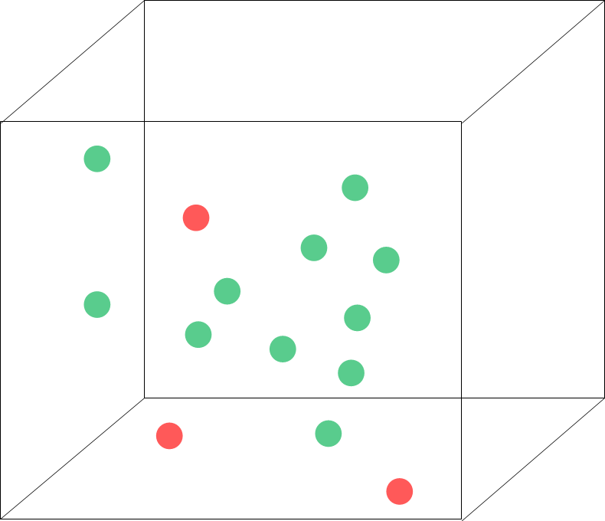
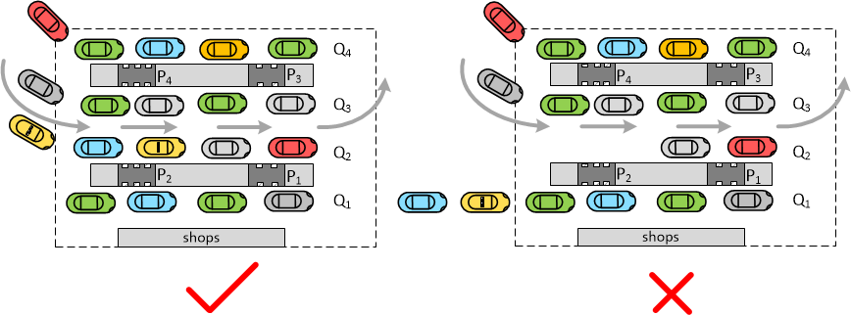
Queue System
Estimate Visit (Consumer Number) based on time spent
Ignore transfers
Each queue share the same time spent on average
Notes:
In this figure, we only find out the red point, which is taxi drivers’ refueling event, we also want to find out the total number of points.
As we know, the vehicles are waiting in a queue for refueling, it is a typical queue system in the gas stations. So we use the queue system model to estimate the total visit based on time spent.
There are two assumptions we make in this paper.
First we ignore transfer, as we know, in general there are several queues in a gas station, we assume if a vehicle join a queue, it will not transfer to other queues.
Second is each queue share the same time spent on average. Because we assume users’ are rational and the length of each queue will be equal.

Slide 17
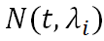
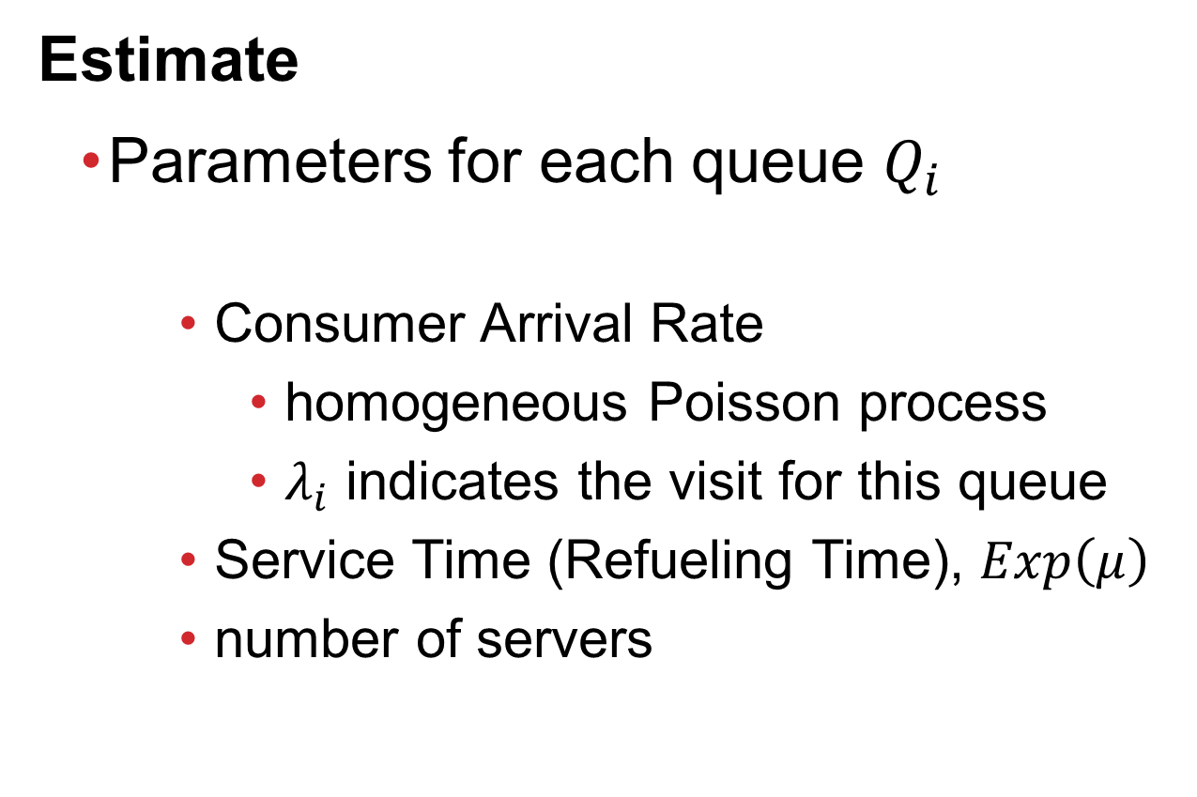
Estimate
Parameters for each queue $Q_{i}$
Consumer Arrival Rate
homogeneous Poisson process
$λ_{i}$ indicates the visit for this queue
Service Time (Refueling Time), $Exp\left(μ\right)$
number of servers
Notes:
To relate visit to time spent in the queue system, there are several parameters.
First is consumer arrival rate, which is a homogeneous poisson process, which lambda I means the total visit in this queue.
Service time means the real refueling time, which corresponds to a exponential distribution
The number of servers, which means in each queue, how many servers can work at the same time

Slide 18
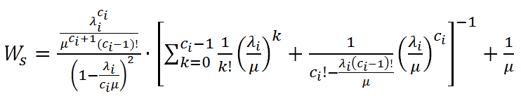
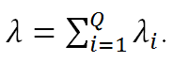
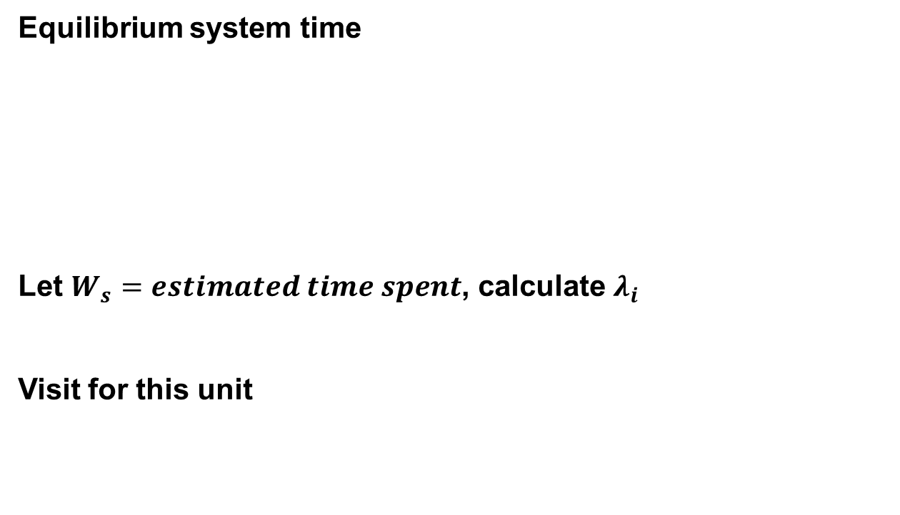
Equilibrium system time
Let $W_{s}=estimated time spent$, calculate $λ_{i}$
Visit for this unit
Notes:
For queue system, the equilibrium system time is calculated as follows
The equilibrium system time is represented by estimated time spent in the cell
Total number is the sum of each queue’s number

Slide 19
Experiment
Notes:
OK, Let’s move forward and see the experiment.

Slide 20
Human labeled datasets
HLD-1 | labeled 250 refueling events on digital maps 200 for training, 50 for evaluation
HLD-2 | Labeled 2,000 candidates True/ False
HLD-3 | 33 trajectories collected by two authors Each trajectory contains a recorded refueling event
HLD-4 | Case study, recorded selected vehicles’ arrival and departure time, and total visit In two stations, each station lasts for 7 days, each days lasts for an hour
Notes:
There are four human labeled datasets for evaluation.
The first one is that we labelled 250 refueling events, 200 for training, which is used to learn the candidate extraction parameters. The remaining ones are used to test.
The second one is after candidate extraction, we labeled 2,000 candidates True or False, which is used to train and test the filtering classifier.
,
The third one is 33 trajectories our authors collected, which contains the raw trajectories and recored refueling detail.
The fourth one is the case study, we go to two gas station, each gas station last for 7 days, each day last for one hour, we records some vehicles’ time spent and the total visits.

Slide 21
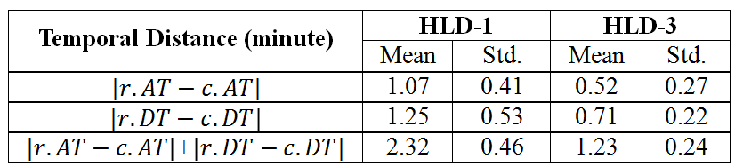
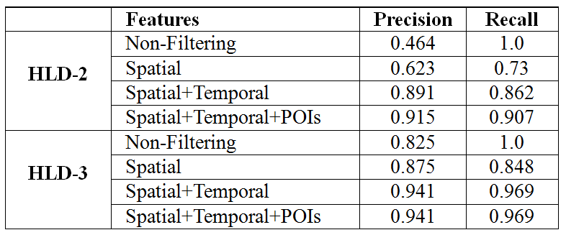
Candidate Extraction
Filtering
Notes:
For the candidate extraction, we measure three distance between the result and labeled ground truth. We find out that the difference is about two minutes. It is smaller for author collected ones, because these trajectroeis are more dense and have lower sampling interval.
For Filtering, we use ten-fold cross validation methods to train and test the classifier, the result show that for both two datasets, the precision and recall is higher than 90 percent.

Slide 22
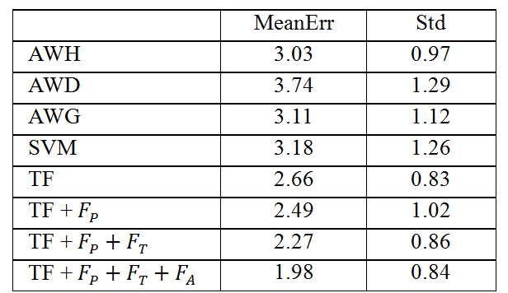
Time Spent Estimate
Treat more than 2 REs as observable data
Baseline
Average With Hour, Day, Gas Station
SVM
Notes:
For time spent experiment, we treat those with more than 2 detected refueling event cell as observable data.
We compare four baseline, the first three is fill the missing value with the average values along one dimension. For example, Average with hour, is the fill the cell’s value with other cells’ value, which has the same hour with the cell.
Another baseline is SVM, we use the contextual features as well as the temporal features to build the classifier.
The result shows Our model can estimate the time spent within the error of 2 minutes.

Slide 23
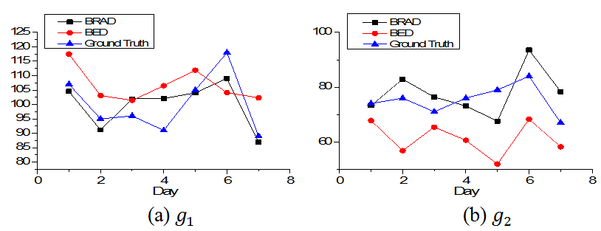
Visit Estimate
Methods
BRAD : using recorded average time spent as equilibrium system time
BED : using estimated time spent as equilibrium system time
Notes:
The third experiment is the visit estimate. This table shows the detail of the two gas stations, the number of queue, the number of servers in each queue and so on.
We compare the methods, brad using the recored average time spent to represent the equilibrium system time, bed using the estimated time spent in our model, to represent the equilibrium system time.
The figure show that for the left station, the estimated result is close to ground truth. For the right gas staion, bed method will underestimate the total visit.

Slide 24
Urban Refueling Analysis
Notes:
Finally, let have a look at the entire city’s refueling behavior.

Slide 25
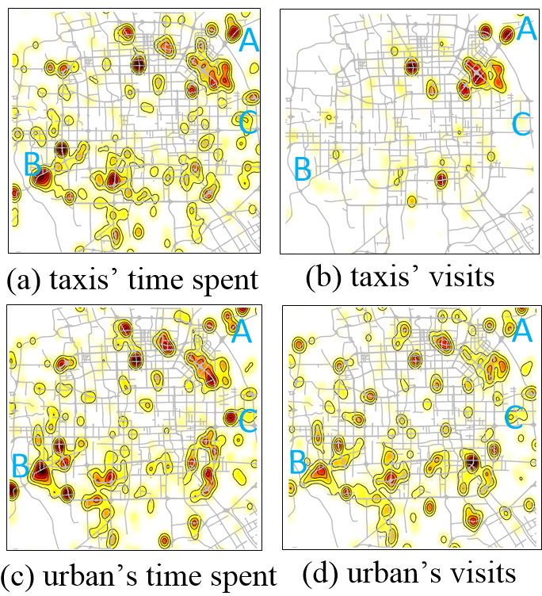
Geographic View
Notes:
For the spatial view, we see taixs’ time spent agree with the urban’s time spent.
For the visit, taxi drivers’ would like to go these places, while other vehicles would also like to visit those places.
Some area, for example, region B is popular, because it is near to the highway entrance, many vehicles refueling there.

Slide 26
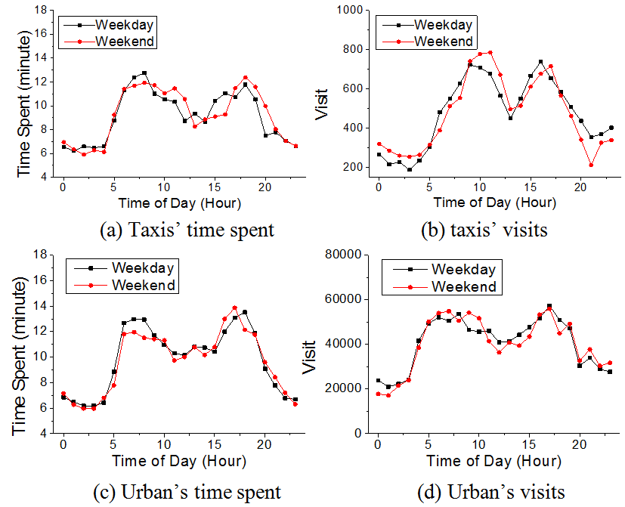
Temporal View
Notes:
For the temporal view, we plot the different pattern for taxis and urban result, as well as weekdays and weekends. All the figures show in the rush hours, many consuemrs choose to refueling in that period.

Slide 27
Discussion
Generalization
Taxi trajectories are just a sampling of the whole vehicles’ mobility
Limitation
Taxi drivers might have distinct refueling preference with household consumer
Refueling behavior in station’s queue is ideally assumed
Notes:
Finally, we discuss the issue related to our work.
On one hand, our work is not limited to taxis, it can be generalized to other vehicles’ mobility, taxis are just a sampling of the total vehicles.
On the other hand, there might be some bias for taxi drivers, they might have distinct refueling preference with other consumers. What is more, the refueling behavior in the stations’ queue is ideally assumed.

Slide 28
Thanks!

